Slide 1
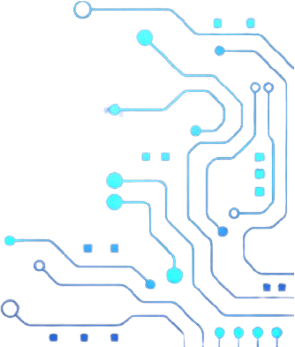


2025-26
It
code
Fest
Craft
AMU
Computer Department
9:30 AM - 02:00 PM
20th August 2025
All the students of computer department are request to participate in the following events
Coding Competitions & Hackathons
Gaming & App Development Contests
Fun Tech Quizzes and Prizes
https://www.amu.ac.in/department/computer-science

